Slide 1

MRI Intro

Slide 2
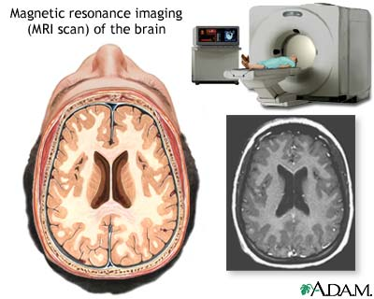
Magnetic resonance imaging (MRI)

Slide 3
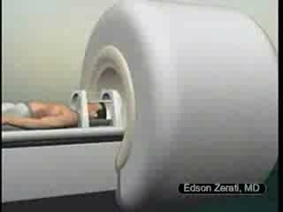

Slide 4
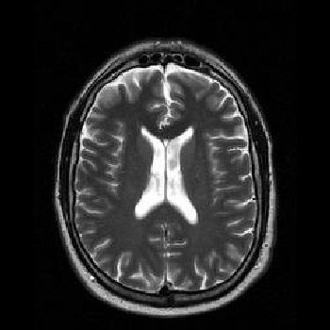
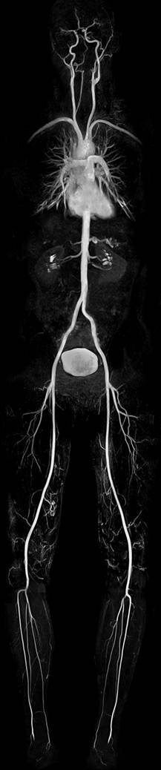
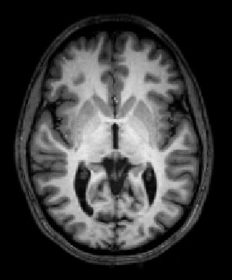
Anatomy - Separating tissues
1T
2T

Slide 5
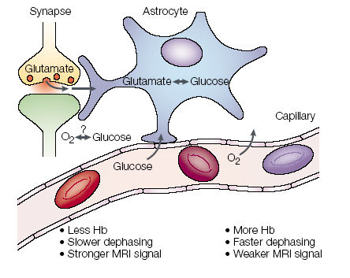
Neurovascular coupling
Heeger et. al. 2002

Slide 6
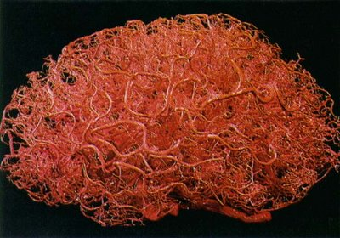
Hemodynamics

Slide 7
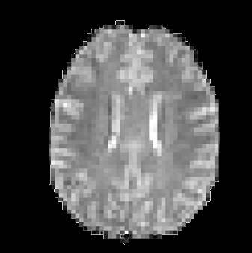
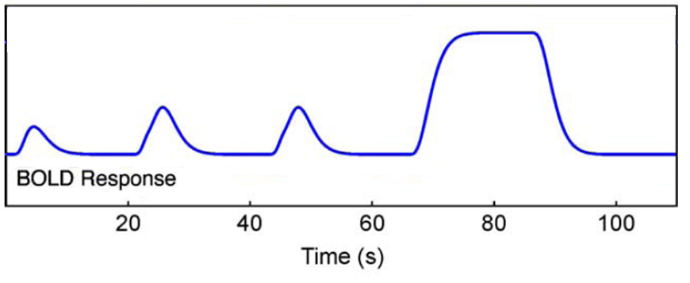
Hemodynamic changes
Time
Heeger et. al. 2002

Slide 8
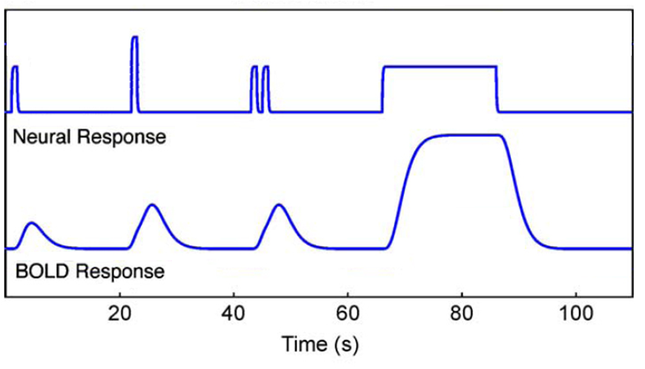
Hemodynamic response

Slide 9
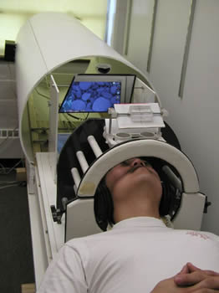
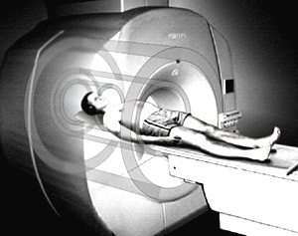
Experiment

Slide 10
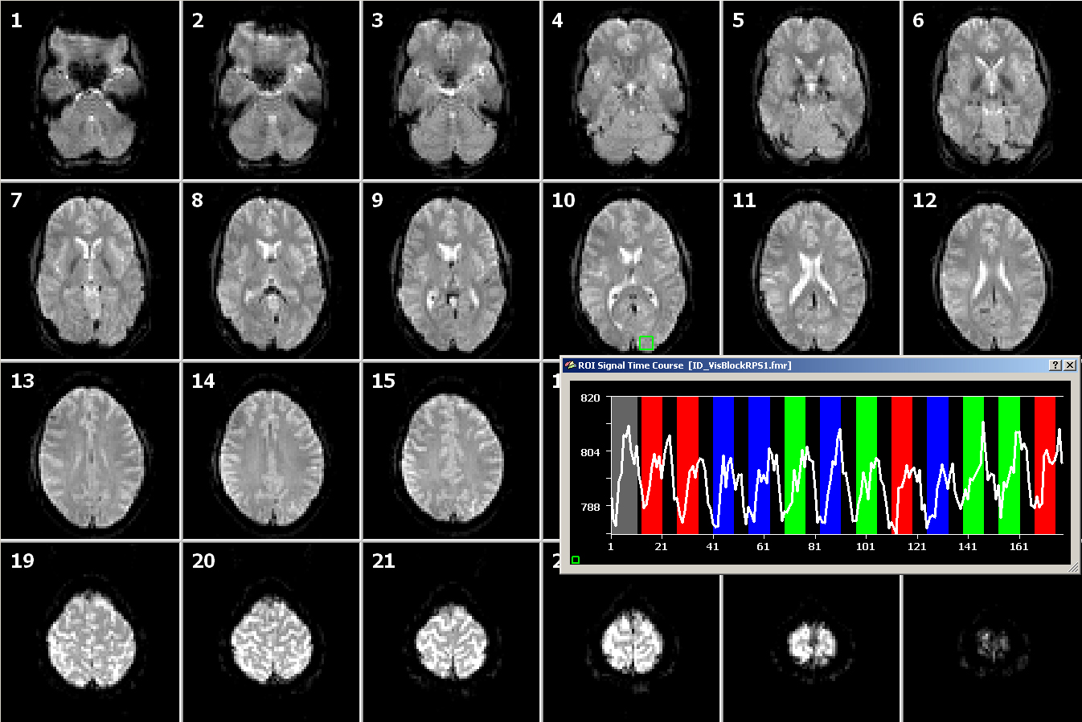
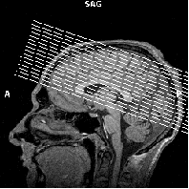
scan/volume fMRI
Front
R
L
Back
24 slices every 1.5 seconds

Slide 11
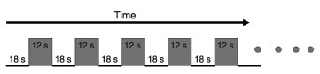
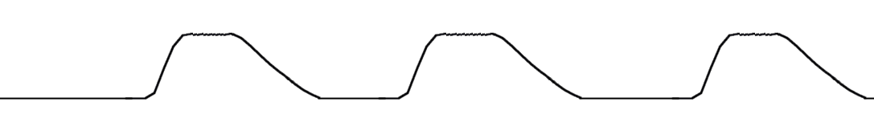
Modelling the experiment
Stimulus or experiment structure
Convolution with HRF
Model of hemodynamics

Slide 12

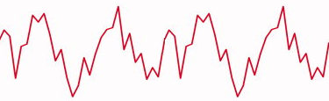
Correlation
Where in the brain was there similar activity?

Slide 13
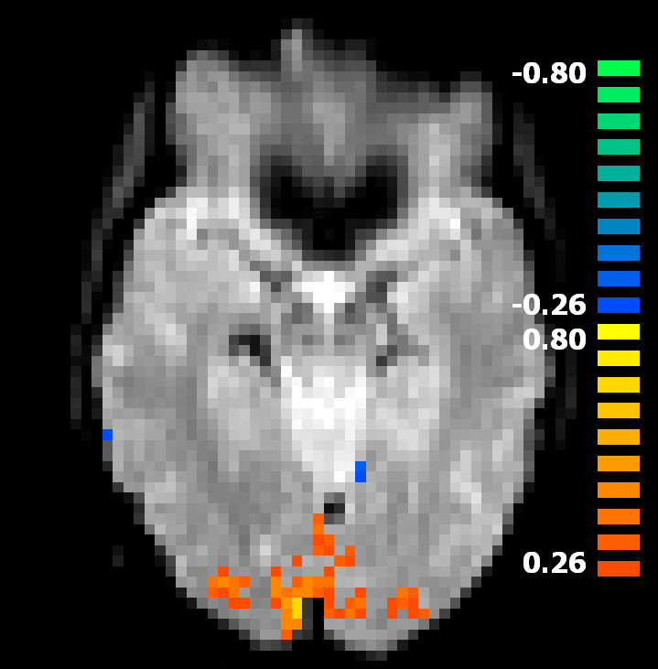
Correlation maps - localization
Paint the voxels according to the correlation level

